Slide 1
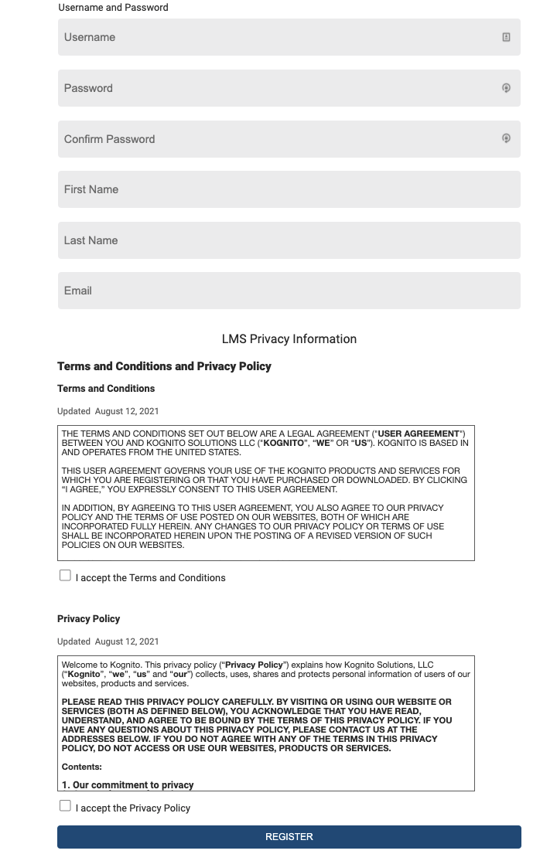
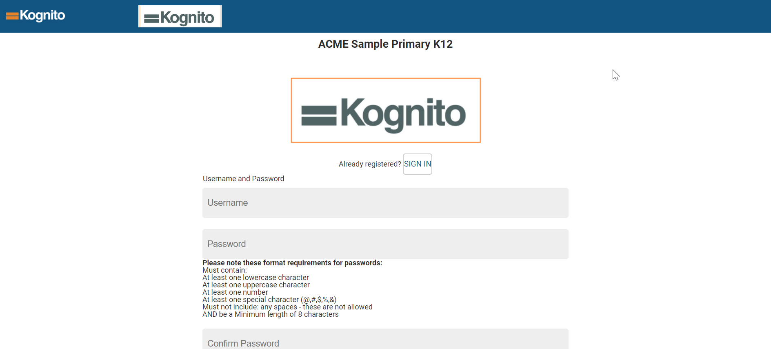
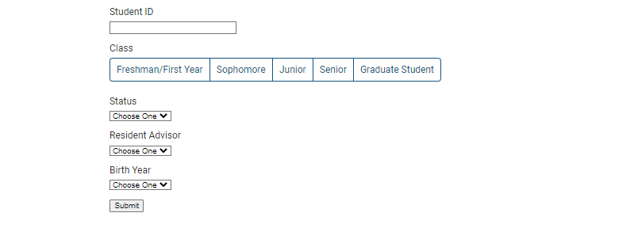
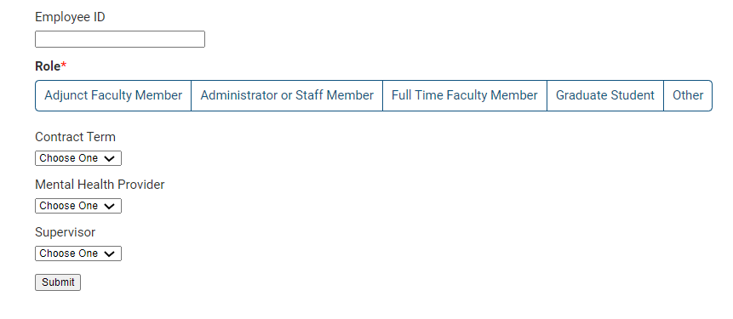

Kognito Campus 2.0 User flow
Please follow the below steps to access the Kognito courses at your school.
1
Navigate to
akron.kognito.com
Select your school from the list presented to you
Create your username and password. If you received an automated email, please check your spam folder and continue to create your password
Kognito University
2
Once successfully logged in, your User Type is pre-selected, please hit ‘Submit’, you do not need to answer any additional questions
If you are experiencing issues, please contact support@kognito.com
Available on weekdays from 8 – 5pm CST

Slide 2
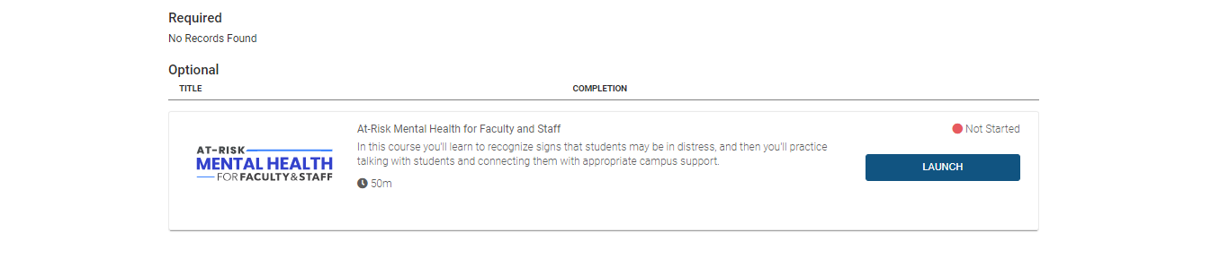
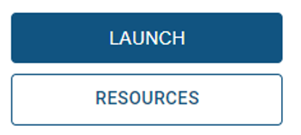
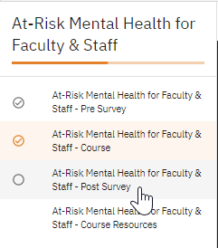
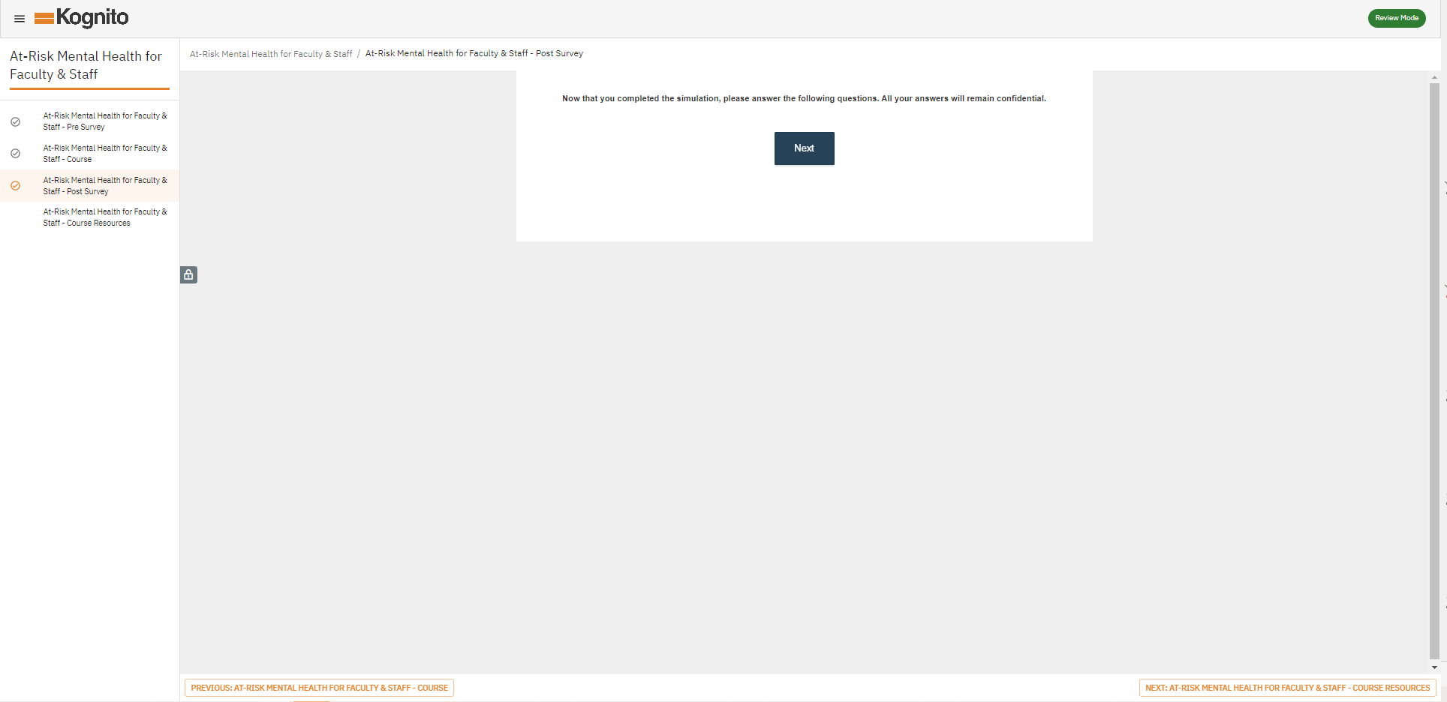

Kognito Campus 2.0 User flow
Please follow the below steps to access the Kognito courses at your school.
3
Open your training by clicking Launch.
To view Resources, select Resources.
4
Once you have completed the ‘Conclusion’ section of the simulation, you are done with the course content.
Please complete the post-survey to receive your certificate.
Use the orange navigation button in the bottom left corner of the menu or your navigation menu on the right side of the screen.
Course Menu
Navigation Button
If you are experiencing issues, please contact support@kognito.com
Available on weekdays from 8 – 5pm CST

Slide 3
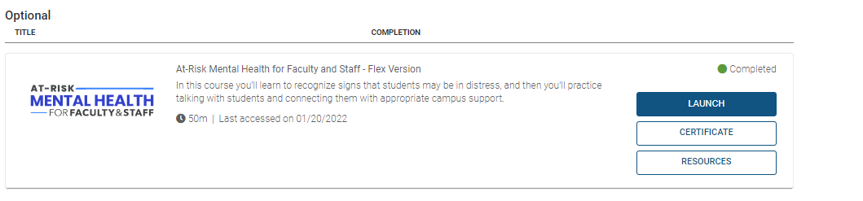
Kognito Campus 2.0 User flow
Please follow the below steps to access the Kognito courses at your school.
To Receive Your Certificate Of Completion:
To receive a ‘Completed’ status for your Kognito course, you will need to complete:
  Course pre-survey
  Course
  Course post survey
Once these three tasks have been completed, there will be a checkmark next to them in the course menu. You will navigate back to your home page and receive the option to access your certificate.
Course Menu
Navigation Button
Access to certificate
If you are experiencing issues, please contact support@kognito.com
Available on weekdays from 8 – 5pm CST

